Slide 1
To our new Junior Infants
We are looking forward to seeing you after the summer holidays.

Slide 2
This is your new school

Slide 3
You will play in this playground with your friends.

Slide 4
Mrs. Browne will be your teacher. She is very nice and has lots of fun activities ready for you.

Slide 5
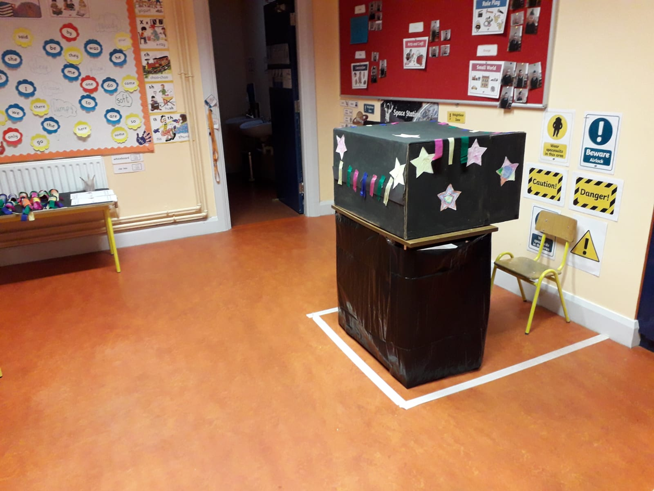
This is your classroom. There are lots of toys and games for you to play with.

Slide 6
This is the library where you can read lots of books.

Slide 7
You will do P.E. in the hall on wet days. P.E. is great fun.

Slide 8
These are the other staff who work in our school.

Slide 9
You will make lots of friends and have loads of fun in Aughadreena N.S.
This Photo by Unknown Author is licensed under CC BY-NC-ND

